Slide 1

DEFAULT CREDIT CARD.
STATISTICAL MACHINE LEARNING PROJECT
DATASET

Slide 2
PRESENTED BY: NAME : S.PRANAV HALL no : 2203A52178 S.NO : 49 TO: Ramesh Dadi SIR. Faculty of STATML
SECTION : CSE(AI&ML)AA SECTION.

Slide 3
INTRODUCTION ABOUT PROJECT:
PROBLEM STATEMENT: “Build a machine learning model to predict credit card payment defaults using customer payment history dataset and demographic information, aiding in risk assessment and portfolio management for a financial institution”.
ABOUT DATASET: Certainly! The "Default Credit Card" dataset is a collection of information about credit card holders. It includes details such as their credit limit, age, gender, education level, and past payment history. The dataset also indicates whether each cardholder defaulted on their payment in the following month.
The main goal of using this dataset is to create a predictive model that can help determine which credit card holders are likely to default on their next payment. This model can be valuable for financial institutions to assess and manage credit risk, assign credit scores, and make informed decisions about lending and managing credit card accounts.

Slide 4
Certainly! Here's a simple description of each feature in the "Default Credit Card" dataset:
1. LIMIT_BAL: This represents the credit card holder's credit limit, which is the maximum amount they can borrow.
2. SEX: This indicates the gender of the cardholder (1 for male, 2 for female).
3. EDUCATION:This shows the education level of the cardholder (1 for graduate school, 2 for university, 3 for high school, 4 for others).
4. MARRIAGE: It specifies the marital status of the cardholder (1 for married, 2 for single, 3 for others).
5. AGE: This is the age of the cardholder, indicating how old they are.
6. PAY_0 to PAY_6:** These columns represent the repayment status for the last six months. PAY_0 is the most recent month, and PAY_6 is the sixth month ago. The values indicate the payment delay status (-1 = pay duly, 1 = payment delay for one month, 2 = payment delay for two months, ..., 9 = payment delay for nine months or more).
7. BILL_AMT1 to BILL_AMT6:** These columns represent the bill statement amount for the last six months. Similar to PAY_0 to PAY_6, BILL_AMT1 is the most recent month's bill, and BILL_AMT6 is the sixth month ago.
8. PAY_AMT1 to PAY_AMT6:** These columns represent the amount of previous payment for the last six months. PAY_AMT1 is the most recent month's payment, and PAY_AMT6 is the sixth month ago.
9. default payment_next_month:This is the target variable, indicating whether the cardholder defaulted on their payment in the following month.

Slide 5
ABOUT TARGET VARIABLES:
The target variable, also known as the dependent variable or response variable, is a crucial component in a dataset used for machine learning. It represents the outcome or the variable that you want to predict or understand based on the other variables (features) in the dataset.
In the "Default Credit Card" dataset, the target variable is named "default payment_next_month." It indicates whether a credit card holder defaulted on their payment in the following month. This binary variable takes on two values:
1: Indicates that the cardholder defaulted on their payment in the following month.
0: Indicates that the cardholder did not default on their payment in the following month.
The goal when working with this dataset is to use the other features (credit limit, age, education, payment history, etc.) to build a predictive model that can accurately predict whether a credit card holder will default (1) or not (0) in the next month. The target variable is essential because it's what you want your machine learning model to learn and make predictions about.

Slide 6
CLASSIFICATION:
Classification is a type of supervised machine learning where the goal is to assign predefined categories or labels to input data. It is used when the output is a discrete or categorical variable. Here are some common classification algorithms and a brief explanation of each:
1. Logistic Regression:
- Logistic regression is a binary classification algorithm used to model the probability that a given input belongs to a particular class.
- It's used when the target variable is binary (two classes).
- Example: Predicting whether an email is spam (1) or not spam (0) based on its content features.
2. Perceptron Learning:
- The perceptron is a simple linear binary classification algorithm.
- It learns a linear decision boundary to separate two classes.
- Example: Classifying handwritten digits as either 0 or 1 based on pixel values.
3. Support Vector Machine (SVM):
- SVM is a powerful classification algorithm used for both binary and multiclass classification.
- It finds the optimal hyperplane that maximizes the margin between classes.
- Example: Identifying whether a patient has a specific disease (positive class) or not (negative class) based on medical test results.
By analysis I conclude that my dataset is a classification, so I used or done all above learning methods to my dataset to find accuracy and min_max errors.

Slide 7
K-Nearest Neighbors (KNN):
K-Nearest Neighbors (KNN) is a simple and intuitive machine learning algorithm used for classification and regression tasks. It's a non-parametric, instance-based learning method that makes predictions based on the similarity between new data points and existing data in a dataset. Here's a definition of KNN:
K-Nearest Neighbors (KNN):
K-Nearest Neighbors (KNN) is a supervised machine learning algorithm that uses a proximity-based approach to make predictions for new data points. In KNN, the prediction for a data point is determined by examining the class (in classification) or value (in regression) of its K nearest neighbors in the training dataset. The "K" in KNN represents the number of nearest neighbors to consider, and the algorithm assigns the class or value that is most common or has the highest frequency among those neighbors. KNN is a versatile algorithm that is simple to understand and implement, making it suitable for various applications but may require careful selection of the K value and can be sensitive to the choice of distance metric.

Slide 8
BOOTSTRAPPING METHOD:
Bootstrapping is a resampling technique used in statistics and machine learning to estimate the sampling distribution of a statistic by repeatedly resampling from the observed data. It's a powerful method for making inferences and assessing the uncertainty of statistical estimates. Here's an overview of the bootstrapping method:
1. **Resampling**:
Bootstrapping involves drawing multiple samples (with replacement) from the observed dataset. These resampled datasets, called "bootstrap samples" or "bootstrap replicates," are of the same size as the original dataset. Since resampling is done with replacement, the same data point can appear multiple times in a single bootstrap sample, while others may be omitted.
2. **Purpose**:
The primary purpose of bootstrapping is to estimate the sampling distribution of a statistic or parameter. Common use cases include estimating the mean, variance, confidence intervals, standard errors, and other summary statistics of a dataset, as well as assessing the variability of model performance metrics in machine learning.
3. **Bootstrap Sample Size**:
The number of bootstrap samples (B) drawn from the original data is typically a user-specified parameter. A larger number of bootstrap samples provides more reliable estimates of the sampling distribution but requires more computation.
4. **Statistical Estimation**:
After creating multiple bootstrap samples, the statistic of interest (e.g., mean, median, standard deviation, regression coefficients) is computed for each bootstrap sample. This results in a distribution of the statistic, which can be used for making inferences about the population or estimating its properties.
5. **Confidence Intervals**:
One of the most common applications of bootstrapping is the construction of confidence intervals. By examining the spread of the bootstrap statistics, you can estimate the uncertainty or confidence level associated with a point estimate of a parameter. For example, a 95% confidence interval can be constructed by finding the range of values that encompasses the middle 95% of the bootstrap statistics.
6. **Advantages**:
Bootstrapping is valuable when traditional statistical methods are not applicable or are computationally expensive. It makes very few assumptions about the underlying data distribution and is robust in various scenarios, such as small sample sizes, non-normal data, and complex models.

Slide 9
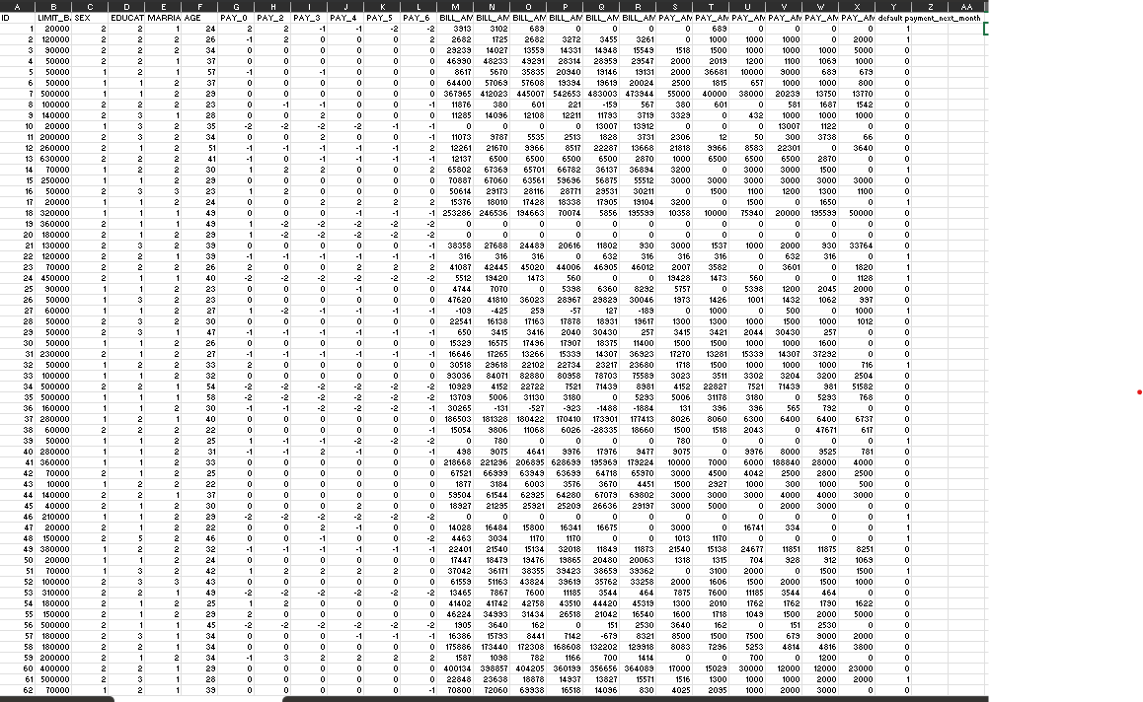
DATASET:

Slide 10
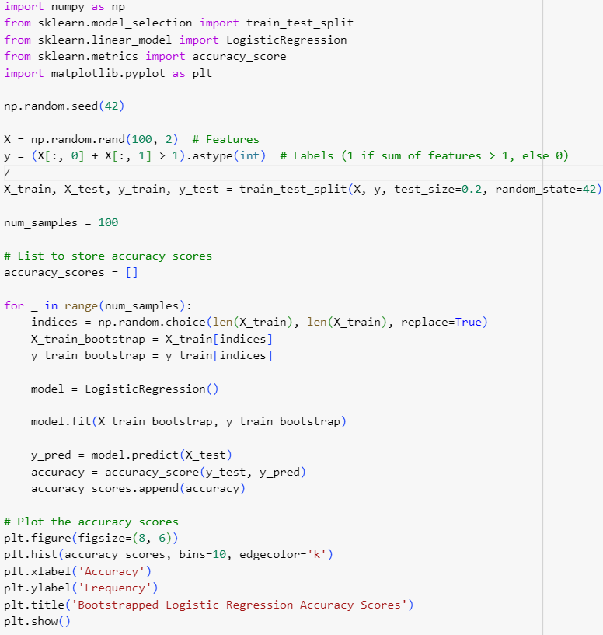
ABOUT THE CODE: logistic regression & Bootstrapping:

Slide 11
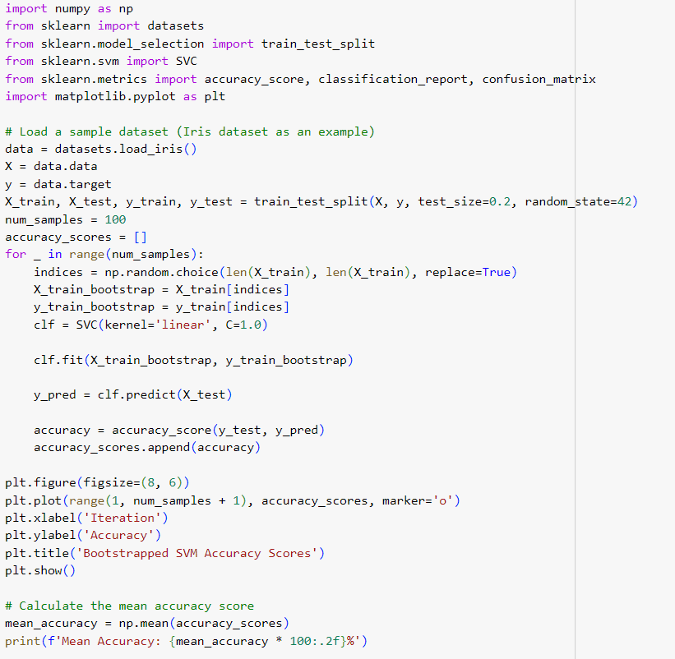
Bootstrapping on SVC:

Slide 12
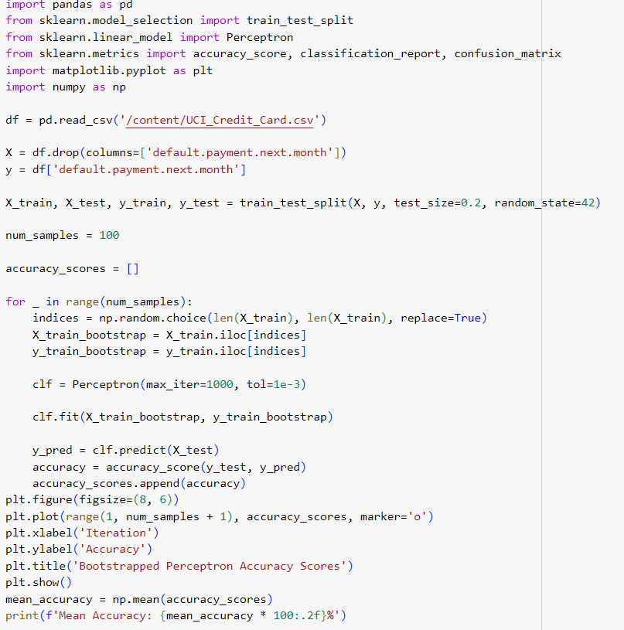
Bootstrapping on Perceptron learning:

Slide 13
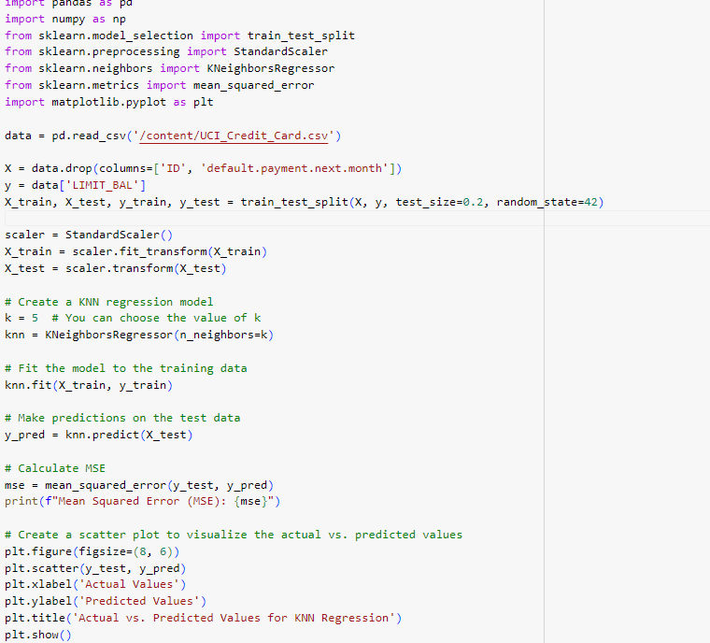
Bootstrapping on KNN:

Slide 14
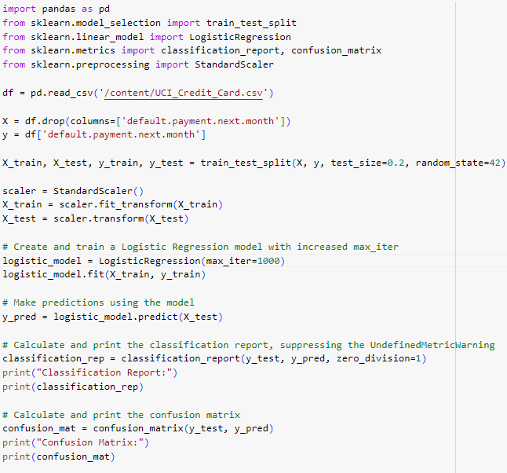
Code for classification report & confusion matrix:

Slide 15
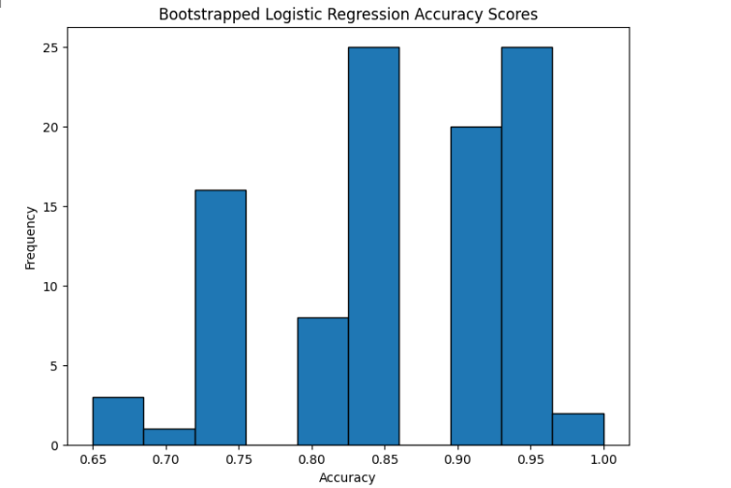
GRAPHS OF LOGESTIC REGRESSION

Slide 16
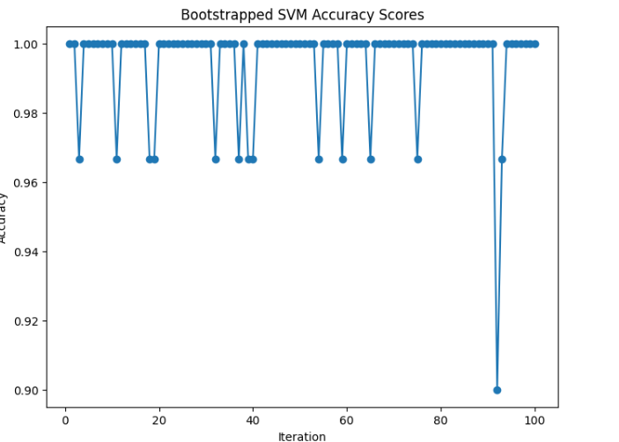
GRAPHS OF SVM:

Slide 17
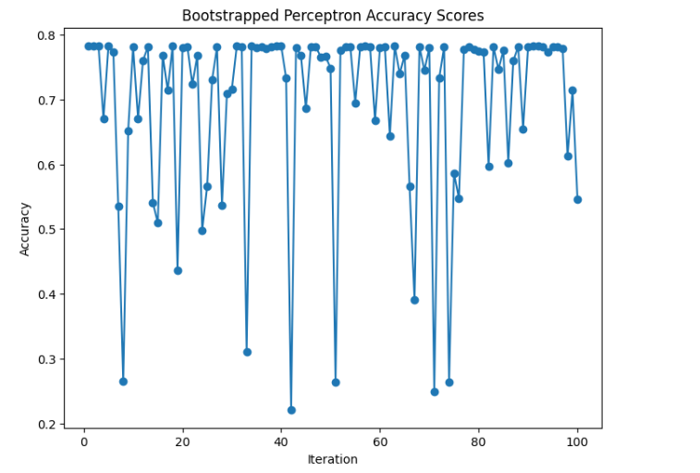
GRAPH OF PERCEPTRON LEARNING:

Slide 18
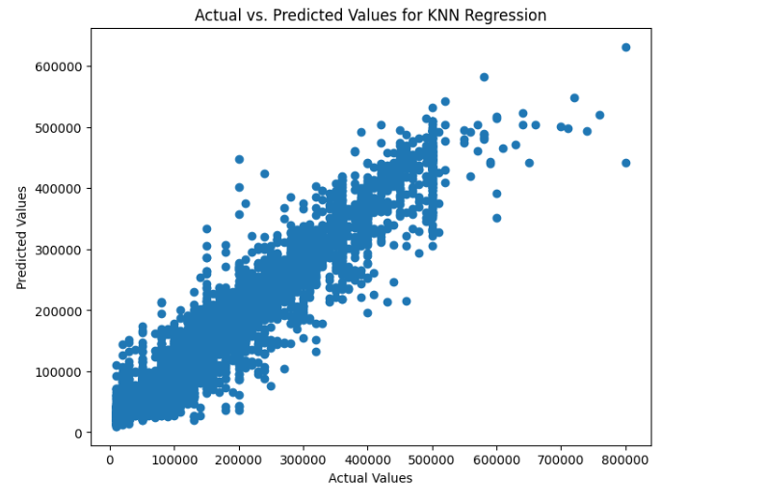
GRAPH OF KNN:

Slide 19
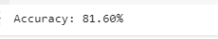
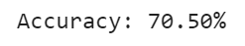
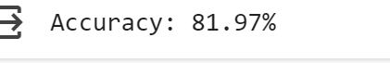
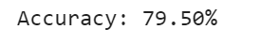
FINAL OUTPUT:
LOGESTIC REGRESSION OUTPUT:
* PERCEPTRON LEARNING:
* SVM OUTPUT:
KNN:

Slide 20
CONCLUSION:
From the above table we can see that the accuracy of all four algorithms before the applying bootstrapped method in that, The logestic regression model’s predictions given the Accuracy: 81.60%.
The support vector regression model’s predictions given the Accuracy: 81.97
The perceptron learning model given the accuracy: 70.50%
The K-Nearest Neighbor (KNN) regression model given the Accuracy:79.50%
From the data we can say that the model support vector machine gave the highest accuracy percentage (i.e 81.97%) so we can say the support vector machine model is the more accuracte compare to all three algorithms. So the model svm is best the machine learning algorithm to apply the credit card dataset. By applying SVM in real time problems this will help the bankers to find the faurd credit card client in seconds of time. BY this the empolyees in banks can save their time in finding a faurd credit card and also decresae their workload.

Slide 21
1.Overall Objective:
The primary goal of this analysis is to predict whether credit card holders are likely to default on their payments in the following month based on various features.
Machine learning models are trained and evaluated to assist financial institutions in managing credit risk, making informed lending decisions, and reducing potential losses.
Data Splitting and Scaling:
The dataset was split into training and testing sets to assess model generalization.
Feature scaling was applied to standardize the data and improve model performance.
Future Improvements:
Further analysis and model tuning can be performed to enhance prediction accuracy.
Additional classification algorithms and feature engineering techniques can be explored to improve model robustness.
In summary, this analysis showcases the use of machine learning to predict credit card defaults based on customer attributes and payment history. The provided code serves as a starting point for credit risk assessment, but further refinement and evaluation are essential to build a reliable predictive model for real-world applications.

Slide 22
THANK YOU.
GITHUB LINK: https://github.com/solthipranav/review-.git

